Slide 1

SEMS – Enterprise Team Foundation Server NTI
PreNTI to Qualify Presentation
Mike O’Brien
Nate Smith
Notes:
A full phase review should have no more than 40 slides, and the speakers should only talk in total for no more than 40 minutes. The remaining 20 minutes of the meeting will be used in discussions.

Slide 2
Executive Summary
Objective:
Provide an Enterprise Application Lifecycle Management Service for all 3M Software teams.
Resource requirements:
1.25 FTE for 7 months
Review recommendation:
Pre-NTI to Deploy
Notes:
This “Executive Summary” is to summarize this presentation. In most cases this slide will end with the team’s recommendation for how to proceed with this project. For example, this slide might end with “Move from Qualify to Deploy” or “Complete all technical development and then Archive Close the project”. For a mid-phase review, “Proceed with project as planned”

Slide 3
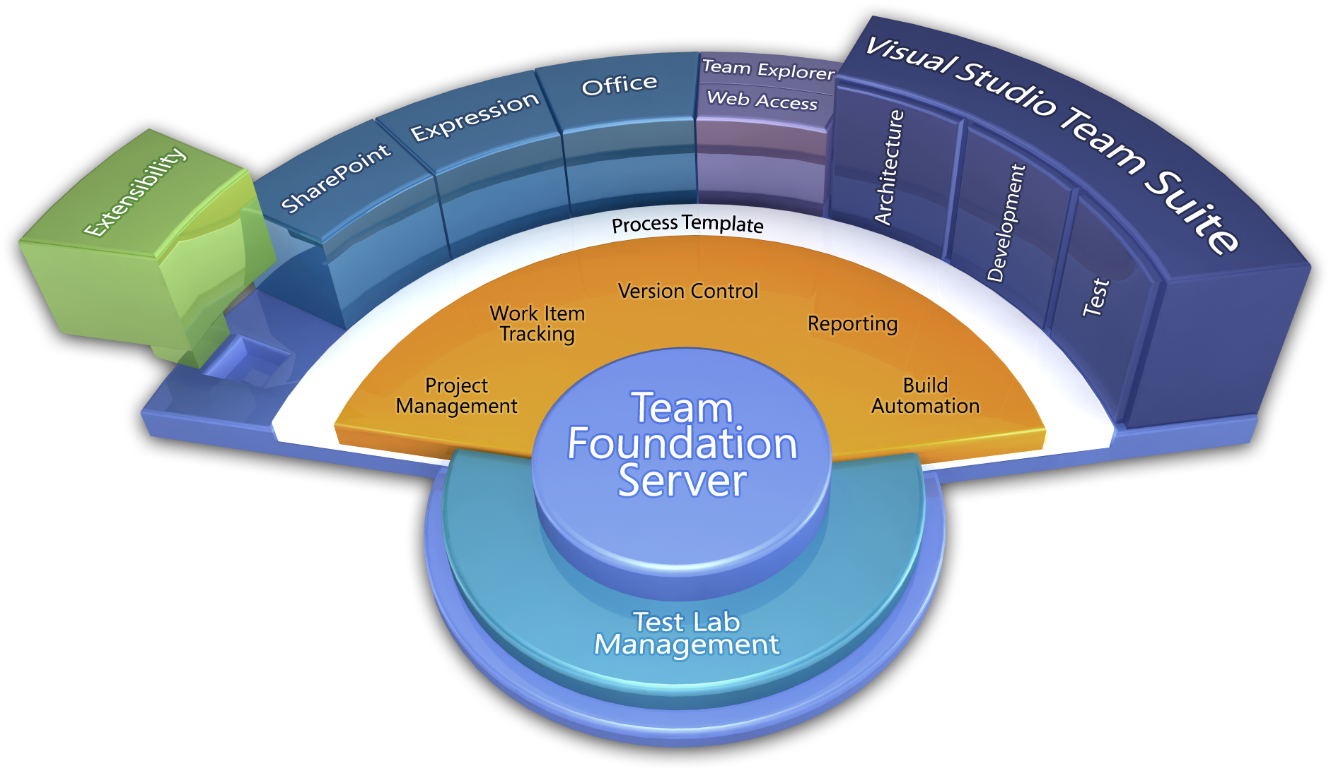
What is Team Foundation Server (TFS)?
Team Foundation Server is a Microsoft product which provides source code management, reporting, requirements management, project management, automated builds, lab management, testing and release management capabilities.
Process / Optimization
Project Management
Requirements Management
Design & Architecture
Release Management
Development
QA & Test
Application Lifecycle Management (ALM)
Application Lifecycle Management using Visual Studio Team Foundation Server provides proven practices to manage application lifecycle. Manage source code across teams; develop, build, and test applications; plan projects, track work, and report progress.

Slide 4
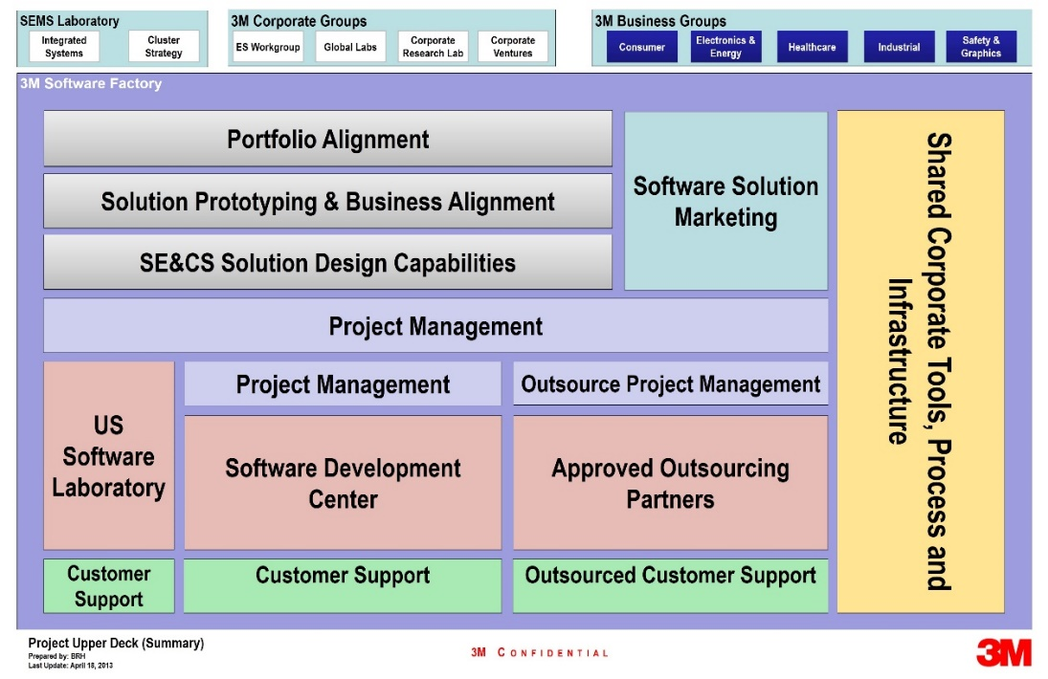
What is 3M Enterprise TFS (ETFS)?
ALM service for all 3M software teams
Infrastructure hosted in 3M Data Centers
High Availability install of Team Foundation Server
Load Balanced across multiple machines
99.9% predicted uptime
System Support 24x7x365 via 3-1000 or http://ithelp.mmm.com
Backups follow 3M standards for data retention
Training Available for TFS and Scrum
Developers
Project Managers/ScrumMasters
Product Owners
Testers
Stakeholders

Slide 5
Project Team
SEMS
Mike O’Brien (Team Leader)
Logesh Rajamanickam
Don Carlson
IT
Everett Taylor (IT Ops Lead)
Division
Dave Schaller
Scott Howard

Slide 6
Pre-NTI to Qualify - Results
Phase | Goal | Result
Pre-NTI | System Requirements | Requirements defined and agreed to by HIS
 | Definition of Service | Service defined and implementation initiated
 | Draft of ‘Cost of Service’ | Cost was defined and agreed upon by HIS
 | Engage additional candidate Divisions | IPD and TSSD(MVSS/SSD) were engaged to gain additional viewpoints.
 | System Architecture | System Architecture document was authored and reviewed by HIS.
 | Draft of Service Level Agreement (SLA) | Completed and reviewed by HIS
Explore | Implement the Service | Service is implemented, and available to all 3M teams.
 | Run Pilot by on-boarding specific HIS and SEMS teams | Pilot was completed with improvement steps identified. Implementation is underway.

Slide 7
Presentation Outline
Team Self-Scoring of NTI Deliverables
Technology Development |  | Implementation of Microsoft Team Foundation Server 2013.
Technology Roadmap |  | Resource constrains may hinder the team velocity, and onboarding pace.
Technology Protection Plan |  | No issues
Market Attractiveness |  | TFS is a market leader, and has been adopted by many large companies.
Business Justification |  | HISD: ETFS was cost effective, and provided better support, backups, and uptime vs. division hosted.
EHS&R Requirements |  | Current users do not have safety or Regulatory needs. IPD and OCS have requirements for use, but do not have capacity to develop a solution.
Preliminary Manufacturing /Implementation Plan |  | Production Level infrastructure active for use, supported by IT Operational Support Team.
Project Plan
OVERALL |  | [i.e. Ready to advance to Deploy phase]
Notes:
You may choose to use the self-scoring of the project as the agenda and show it before each section of the presentation, or you may just show it once at the beginning or the end. But you need to show the team’s self-scoring of the deliverables at least once.

Slide 8
Technology Platform and Roadmap
Consumer
Industrial
Healthcare
Electronics & Energy
Safety & Graphics
Business Groups
SOSD Capture & Share
IPD Next Gen Sterivac
IPD Integrated Cycler Studio
EEESL SmartGrid
TSSD SelfCheck
Selected
Products/Systems
AAD Performance Analysis Tool
Unitek TMP/DSL
HISD Projects
PSD Active Safety
TSSD Cloud Library
Healthcare Process Template
IEC 62304 compliant
Cloud Hybridization
Cross Platform Builds
(iOS / Xamarian / Android / Linux)
Rollup Reporting
(self-service reporting portal)
Service Extensions
Requirements
Authoring Requirements document with Enterprise defined structure, methodology, and process
Deployment Services
Automated build, deploy and testing harnesses
Integrate with HP Quality Centre
Enterprise Software Development Process
Process Template
Project Management
Requirements Management
Version Control
Test Case Management
Build Automation
Reporting
TFS Technology
Platform
TFS

Slide 9
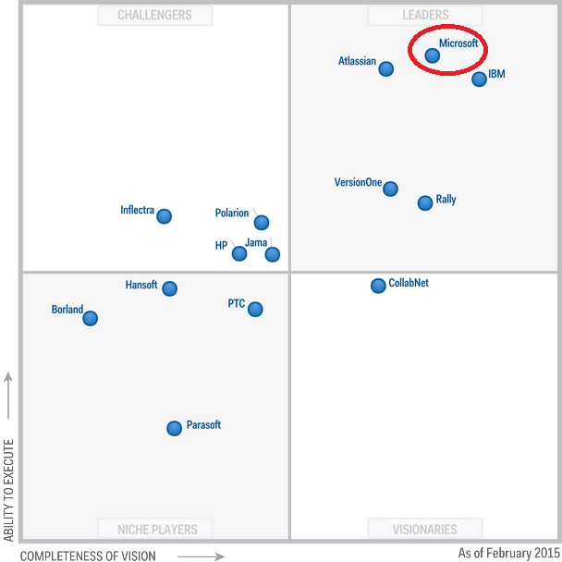






Market Attractiveness
Sources: http://video.ch9.ms/teched/2012/na/DEV343.pptx
Microsoft Tech Sales,
http://download.microsoft.com/documents/customerevidence/21147_HP_13595_final.doc
Notes:
The analysis of Market Attractiveness is different for every project, the content shown is just for reference. Format the slide to appropriately display the information for your project. Please refer to recent presentations given for similar projects. During early phases of the NTI, this section is populated by information that the team collects. There are tools on 3M ATLAS that can help you get some market information. You should list the source of your market information on your slide. Work with division contacts to get more specific market information whenever possible. As an NTI program advances, you should be try to get a financial impact of the technology.

Slide 10
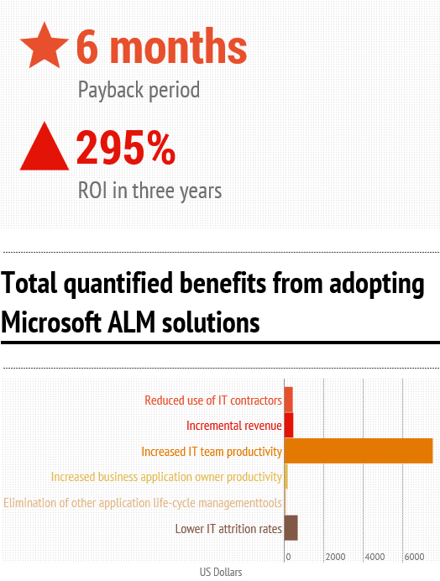
Business Justification – The HISD Story
HIS considered 2 options – HIS and SEMS owned
Total Plan | Cost / Year | Savings / Year
Plan 1 – HIS owned | $151,788 | $251,412
Plan 2 – SEMS owned | $122,388 | $280,812
Non-ETFS | $403,200 | -
Conclusion: ETFS was cost effective, and provided better support, backups, and uptime vs. division hosted.
Infography created by InCycle Software
Source information from Forrester: The Total, Economic Impact of Microsoft Application Life Cycle Mangement
Notes:
The analysis of Business Justification is different for every project. Please refer to recent presentations given for similar projects.
This section should answer a couple questions: How would this technology ‘fit’ into 3M? Why should 3M develop it? You might want to show existing 3M products and businesses that could be improved by leveraging the technology.

Slide 11
Manufacturing Feasibility / Implementation Plan
Transition to IT Managed Cloud Services for operational support
Management of Chargeback
Integrate with 3M software development systems (as needed)
Governance Meetings to be held monthly
Upgrade to new version
Maintain to current patch level
(Need to Finish)
Notes:
Provide some comments about how ready a 3M division would be to implement this technology once it is deployed. Could it be implemented with existing manufacturing systems? Produced by current 3M Suppliers or internally? For algorithms or software, how prepared is a division to launch and support the technology?

Slide 12
Project Plan – Proposed Project Schedule
Pre-NTI – May 2014 [Duration: 5 months]
Objective: Assess Needs of divisions and write a requirements document
Objective: Define an Enterprise Architecture to satisfy the requirements
Objective: Define the Service and capabilities
Explore – October 2014 [Duration: 5 months]
Objective: Implement the Enterprise Architecture and pilot a team within HISD
Qualify – March 2015 [Duration: 7 months]
Objective: Complete Offering (Build/Test Farm, Deployment Service)
Objective: Expand onboarding company wide
Deploy – Feb 2016 [Duration 3 months]
Objective: Finalize deployment to IT
Notes:
A very high level list of key milestones for the next phase is a necessity in order to show that the team has a plan for how to proceed all the way to deploying the technology.
Include two levels of planning:
Overall plan for the rest of the project.
Plan for activities in the next ~6 months.

Slide 13
Cost Model
Operational Cost from IT is paid for by a $10/month per user chargeback
IT charging SEMS for support ($90k annually)
Total cost for operational support (IT + partial SEMS resource): $150k
Users to pay for total operational support: 1250 users
Two Chargebacks: Jan & Feb 2015

Slide 14
Qualify Timeline
Month 1
Month 2
Month 3
Month 4
Month 5
1
2
3
4
5
6
7
8
9
10
11
12
13
14
15
16
17
18
19
20
Establish Governance
Start Governance – initiate Steering Committee
Scrum on ETFS
Implement Enterprise Build Farm
Release Management Deployment Services
External-to-3M access
Migration of teams from SEMSTFS to ETFS
IPD/FSD migration to ETFS
Enterprise Test Controllers
Roll up Reporting
Notes:
Provide a general timeline for the proposed phase of the project. Try to show resolution on a week-by-week level. (It is not required, or even recommended, to use Microsoft Project.) You can draw the timeline in the presentation, or use Excel.

Slide 15
Project Resource Requirements
Team Members
Mike O’Brien SEMS 0.75 FTE
Logesh Rajamanickam SEMS 0.50
Consultants
Don Carlson SEMS
Dave Schaller HIS
Scott Howard HIS
Everett Taylor IT (Operational Support Lead)
Proposed Resources:
Infrastructure $0 K
Microsoft Consultants $100 K
1.25 FTE for 7 months $150 K
Total $250 K
Used Resources
Additional Resources
$0 K
$100 K
$41 K
$51 K
$1.0 K
$25.0 K
$28.0 K

Slide 16
Project Contributions
Poster Sessions
ES Symposium
Annual Event
Overview and Training Presentations
SEMS
CRPL
IPD
FSD
MES(IT)
MobileCOE(IT), TSSD, HIS, IT
Cogent
Notes:
This is not an NTI Deliverable and should be considered option.
For existing projects, provide a list of how the knowledge gained from work on this project has been disseminated throughout 3M.

Slide 17
ETFS Migration Timeline
HIS Target for all Rational Teams migrated
Start Onboarding HIS Teams
Governance Policies Established
Service Available
Start MVSS Migration
IPD/FSD Migrated
All SEMSTFS Teams Migrated
2015
Oct
Nov
Dec
Jan
Feb
Mar
Apr
May
Jun
Jul
Aug
Sep
Oct
Nov
Dec
Today
Transition ETFS to IT – SEMS to maintain consulting role

Slide 18
Comments and Questions
Thank You

Slide 19
Pre-NTI to Qualify - Results
Phase | Goal | Result
Pre-NTI | System Requirements | Requirements defined and agreed to by HIS
 | Definition of Service | Service defined and implementation initiated
 | Draft of ‘Cost of Service’ | Cost was defined and agreed upon by HIS
 | Engage additional candidate Divisions | IPD and TSSD(MVSS/SSD) were engaged to gain additional viewpoints.
 | System Architecture | System Architecture document was authored and reviewed by HIS.
 | Draft of Service Level Agreement (SLA) | Completed and reviewed by HIS

Slide 20
Pre-NTI to Qualify - Results
Phase | Goal | Result
Explore | Implement the Service | Service is implemented, and available to all 3M teams.
 | Run Pilot by on-boarding specific HIS and SEMS teams | Pilot was completed with improvement steps identified. Implementation is underway.
 | Microsoft Engagement | Microsoft approved infrastructure for Enterprise use Draft of service Governance

Slide 21
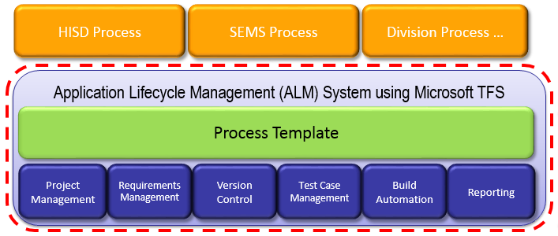
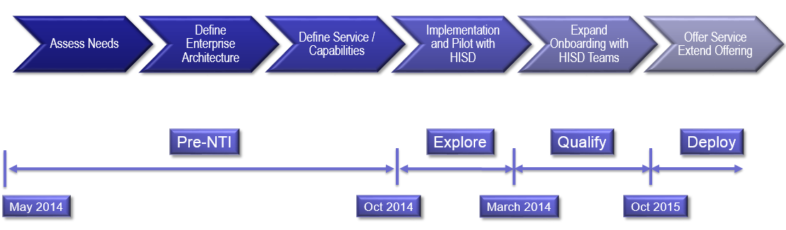
Enterprise Team Foundation Server (NTI)
Businesses – HIS, IPD, TSSD/MVSS, PSD, Unitek
Technology:
Establish an Application Lifecycle Management (ALM) Support System by leveraging Microsoft Team Foundation Server (TFS).
Objective:
Implement an Enterprise Team Foundation Server providing
Develop team of ALM specialists to support 3M software businesses
Status:
Pre-NTI
Progress:
Multiple Divisions engaged – HIS, IPD, TSSD, PSD
Cost of Service Complete
HIS Team onboarding (ongoing)
Engage with Microsoft (MCS team)
220 Users as of Feb 1
January - first usage Division Chargeback
Define System Governance
Construct Enterprise Build Services
Construct Enterprise Test Services
Define & Implement external access
Timeline
Project Management | Test Case Management
Requirements Management | Build Automation
Version Control | Reporting
Key SEMS Contacts: Mike O’Brien

Slide 22
Milestone Timeline by Phase
Assess Needs
Define Enterprise Architecture
Define Service / Capabilities
Implementation and Pilot with HISD
Extend Offering
Expand Onboarding with HISD Teams
Pre-NTI
Explore
Qualify
Deploy
May 2014
October 2014
March 2014
Oct 2015
Notes:
Could add timeframes here instead of dates - ?
Consolidate Pre-NTI milestones - ?

Slide 23
ETFS Team Structure
SEMS
Mike O’Brien
IT Managed Cloud Hosting (Ops)
Everett Taylor (IT Operations Lead)
Division
Logesh Rajamanickam
Don Carlson
Dave Schaller
Scott Howard

